Slide 1

Metservice
Client
Research and Redesign – Mobile Application
Auren Smith & Finlay Macbeth

Slide 2


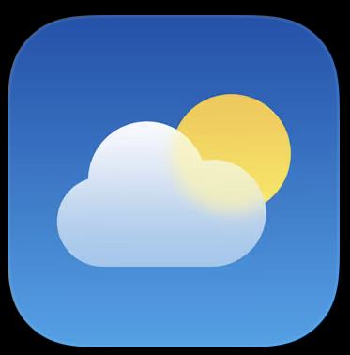
Objective and Strategy
Business & User Requirements
Target Audience
Competitors
Changes to Expect
Business & User Requirements
deliver accurate weather forecasts spanning up to 10 days in the future
look appealing and be simple to navigate
revenue from the application using advertisements.
Target Audience
Using the mobile app “Metservice” The Clients target audience was derived and found as (including but not limited to) Fishing vessel / fleets, power companies, commuters, outdoor recreation. Therefore, it is the direct intention of the client to meet specific needs from these groups of people but cater to individuals and organisations of any nature simultaneously.
Changes to Expect
Competitors
Ads
Windy
Weather

Slide 3
Research
User-Testing & Observations
Tasks for the User to conduct
Interview
Qualitative Questions asked in Post
When is the sunset and sunrise?
What is the weather in a different location?
What will the temperature be at 12am tonight?
What’s the weather 10 days from now?
What is the current wind direction in compass terminology?
What did you like the least about the application?
What are your thoughts on the placement of advertisements?
Would you like to have access to satellite imagery?
On a scale of 1-10 how simple was the application?
On a scale of 1-10 how would you rate the application?
What would you like to see improved?
Out of the 3 weather apps, which one do you prefer the most and why?
Survey
Average age group?
Average frequency of weather application usage?
Length of application usage?
Application use intention?
Preferred appearance for information presentation? (Phrases, Graphs)
Application layout settings preference? (Simplistic, Advanced, Both)
Preferred theme appearance? (Dark, Light)
Opinion on advertisements?
Average location for application use?

Slide 4
Analysis
Survey Analysis
Improvement
Improvement Features & Fixes
Hold and drag module editor.
More advanced modules (e.g., smaller modules).
Pop-up advertisement removal.
Advertisement position change.
Satellite imagery.
10-day forecast module.
Reorder default module positioning.
Scroll to top or scroll bar implementation.
General menu redesign. These features favour a small area of primary interest, and low usage / view times.
Survey Analysis
Most Common Results
Age:16-30
Usage: Daily
Typical Session Time: Less than 30 Seconds
Information Required: 5-10 Day Forecast
Preferred Layout: Combination Phrases / Graphs and Tables (Simplistic and Easily Comprehendible).
Preferred Theme: Dark Mode
Ad Preference: Few or One, in support of the service
Common setting: At Home

Slide 5
Summary
In this Presentation we have covered the most relevant details, for a full conclusion and Analysis we recommend reading the full report

